Slide 1




Analysis of the Top 10 Streamed Songs on Spotify
Wesley Harris
z
This Photo by Unknown author is licensed under CC BY-NC-ND.

Slide 2
Introduction
z
This analysis is intended to show the shared characteristics of the top 10 most streamed songs on Spotify. By analyzing these traits, a production label can determine what their artists need to do in order to gain reputation, earn more revenue, and reach a wider audience internationally.

Slide 3
Agenda
z
Charted Values
Side-By-Side Graph
Danceability Comparison
Energy Comparison
Geographic Streaming Visual

Slide 4
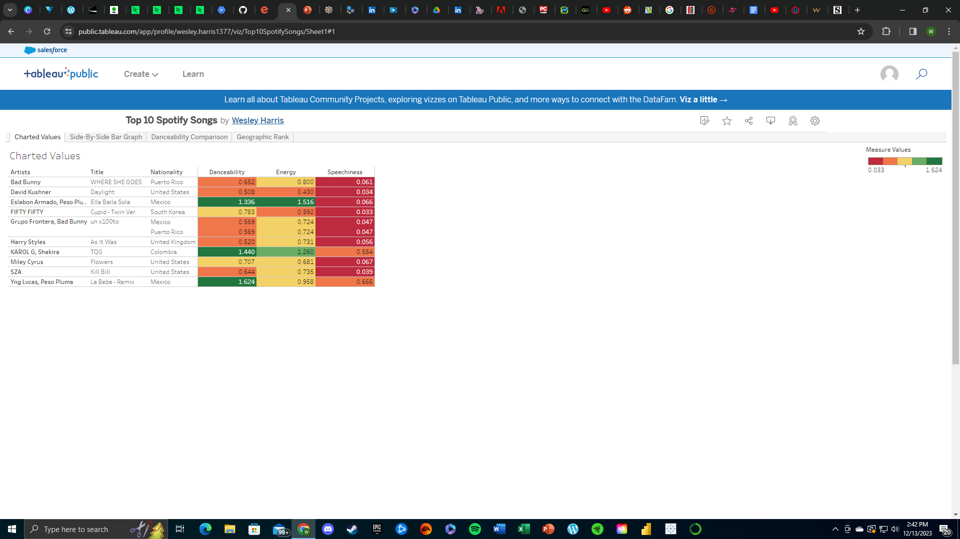
Charted Values
z
Each of these factors are calculated on a scale between 0 and 1
Danceability - Describes how suitable a track is for dancing based on a combination of musical elements including tempo, rhythm stability, beat strength, and overall regularity. A value of 0.0 is least danceable and 1.0 is most danceable.
Energy - Represents a perceptual measure of intensity and activity. Typically, energetic tracks feel fast, loud, and noisy.
Speechiness - Detects the presence of spoken words in a track. The more exclusively speech-like the recording (e.g. talk show, audio book, poetry), the closer to 1.0 the attribute value. Values above 0.66 describe tracks that are probably made entirely of spoken words. Values between 0.33 and 0.66 describe tracks that may contain both music and speech, either in sections or layered, including such cases as rap music. Values below 0.33 most likely represent music and other non-speech-like tracks.
 | Category 1 | Category 2 | Category 3 | Category 4
Item 1 | 4.5 | 2.3 | 1.7 | 5
Item 2 | 3.2 | 5.1 | 4.4 | 3
Item 3 | 2.1 | 1.7 | 2.5 | 2.8
Item 4 | 4.5 | 2.2 | 1.7 | 7

Slide 5

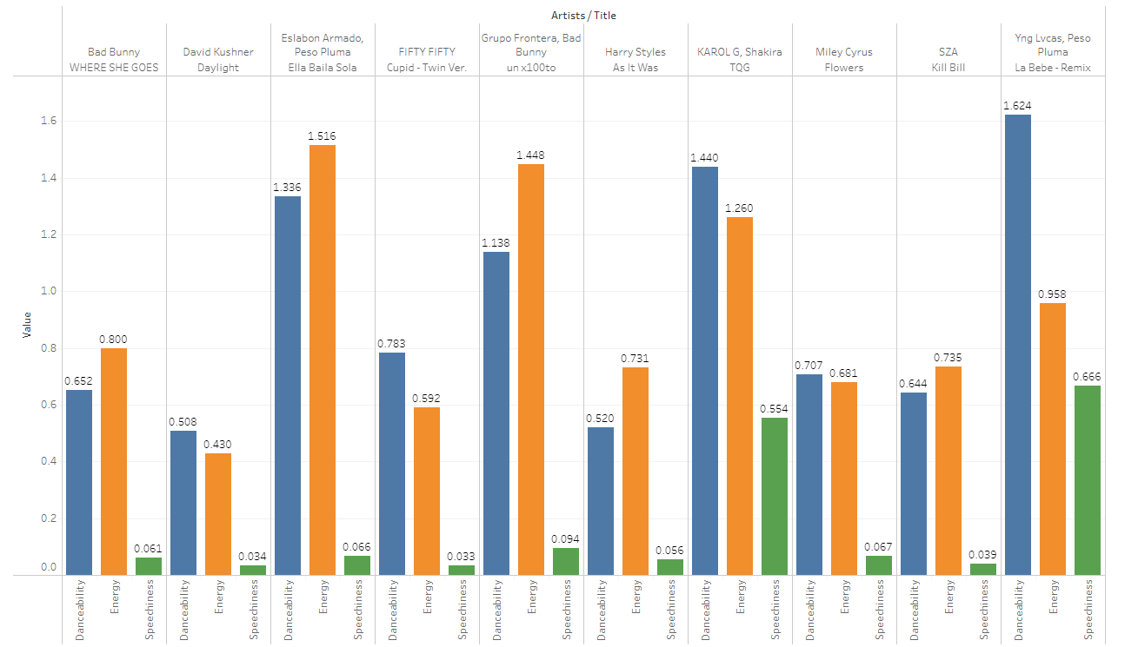




Side-by-Side Bar Graph
z
Title
To start a presentation, go to the Slide Show tab, and select From Beginning.
Title
To display Presenter view, in Slide Show view, on the control bar at the bottom left select the three dots, and then Show Presenter View.
Title
During your presentation, the speaker notes are visible on your monitor, but aren't visible to the audience.
Title
Title
The Notes pane is a box that appears below each slide. Tap it to add notes.
If you don’t see the Notes pane or it is completely minimized, click Notes on the task bar across the bottom of the PowerPoint window.

Slide 6
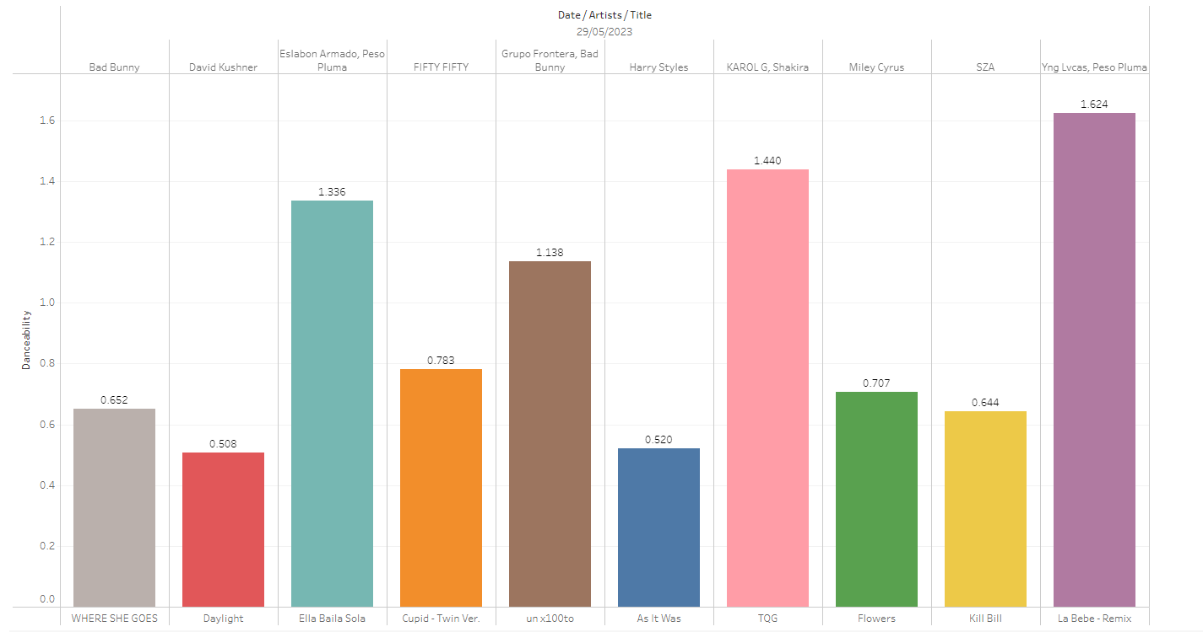
Danceability Comparison
z
Title
To start a presentation, go to the Slide Show tab, and select From Beginning.
Title
To display Presenter view, in Slide Show view, on the control bar at the bottom left select the three dots, and then Show Presenter View.
Title
During your presentation, the speaker notes are visible on your monitor, but aren't visible to the audience.
Title
Title
The Notes pane is a box that appears below each slide. Tap it to add notes.
If you don’t see the Notes pane or it is completely minimized, click Notes on the task bar across the bottom of the PowerPoint window.

Slide 7
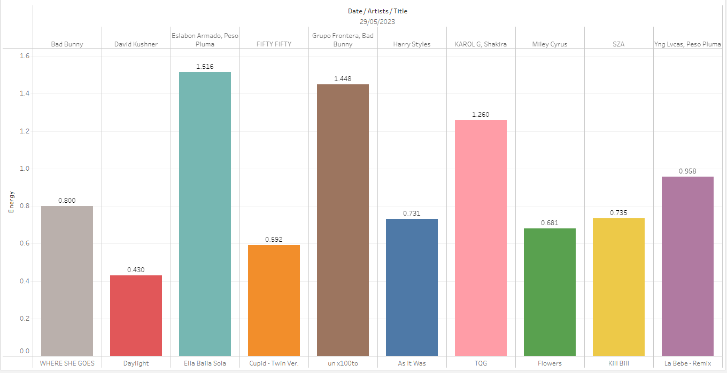
Energy Comparison
z
Title
To start a presentation, go to the Slide Show tab, and select From Beginning.
Title
To display Presenter view, in Slide Show view, on the control bar at the bottom left select the three dots, and then Show Presenter View.
Title
During your presentation, the speaker notes are visible on your monitor, but aren't visible to the audience.
Title
Title
The Notes pane is a box that appears below each slide. Tap it to add notes.
If you don’t see the Notes pane or it is completely minimized, click Notes on the task bar across the bottom of the PowerPoint window.

Slide 8
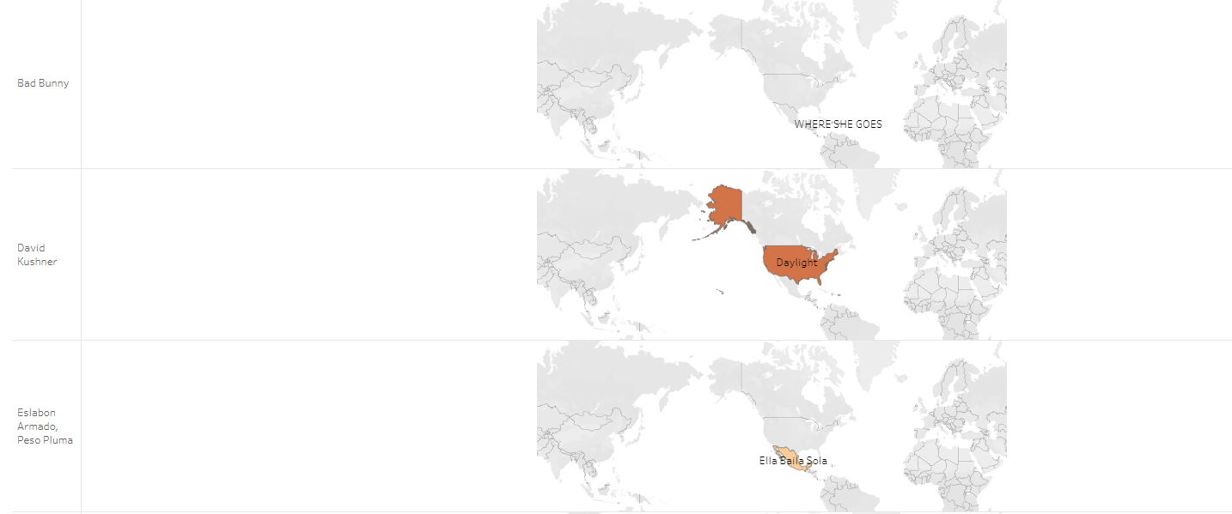
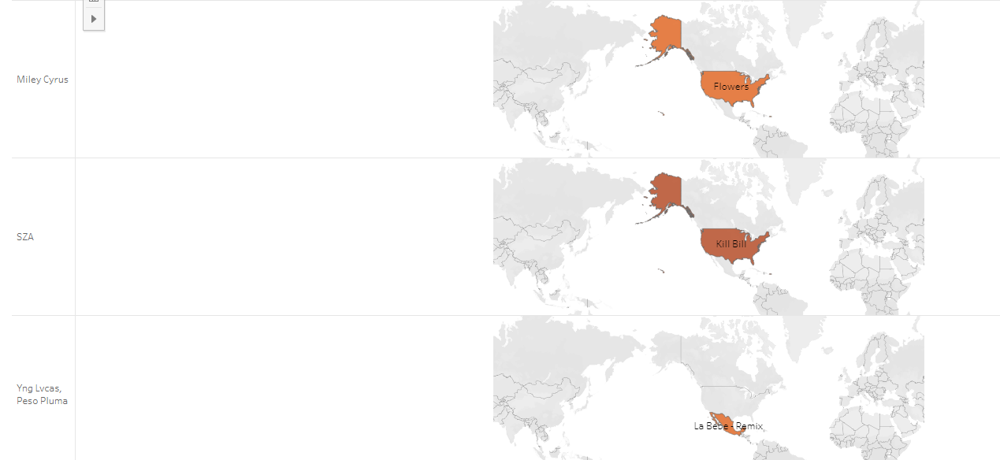
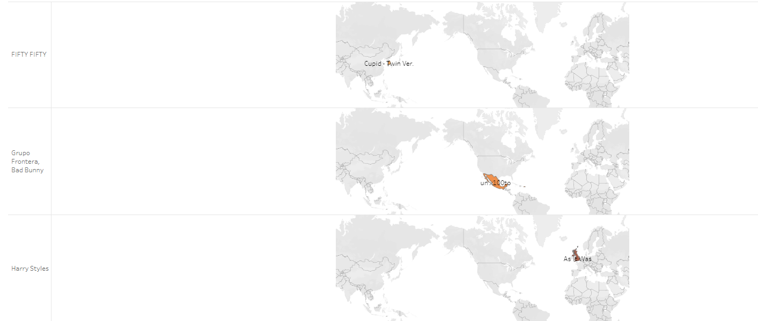
Geographic Streaming Locations
z

Slide 9
z
To Summarize:
Roughly 60% of Spotify's top ten streamed songs had high Danceability and Energy values
Roughly 80% of the top ten streamed songs had low Speechiness values
The top three streamed songs were streamed the most in the US and Mexico
My Recommendation:
Focus on producing songs in Spanish and English to target US and Mexico demographic
Have Danceability and Energy values above 0.6
Create songs that are easy to dance to, lyrics don't matter as much
More Streams = More Revenue and Reputation

Slide 10
Thank you!
z

